Slide 1
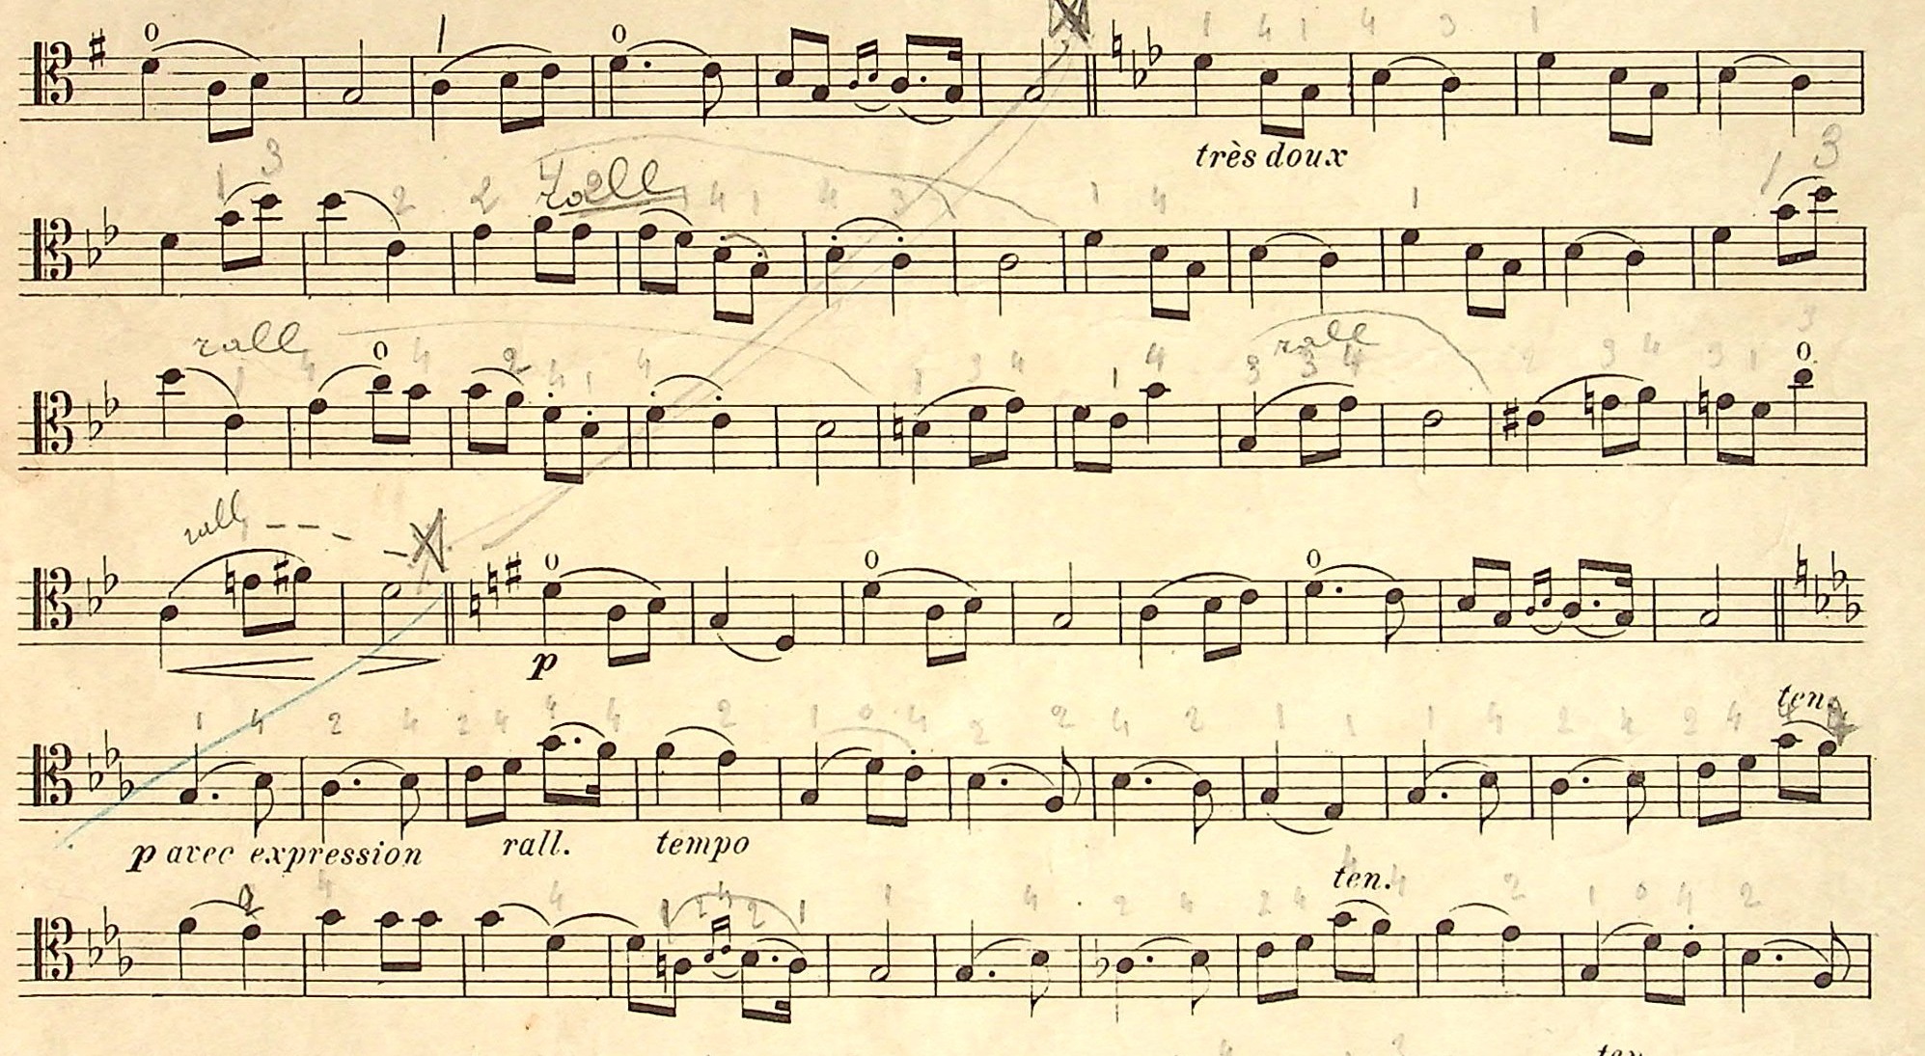


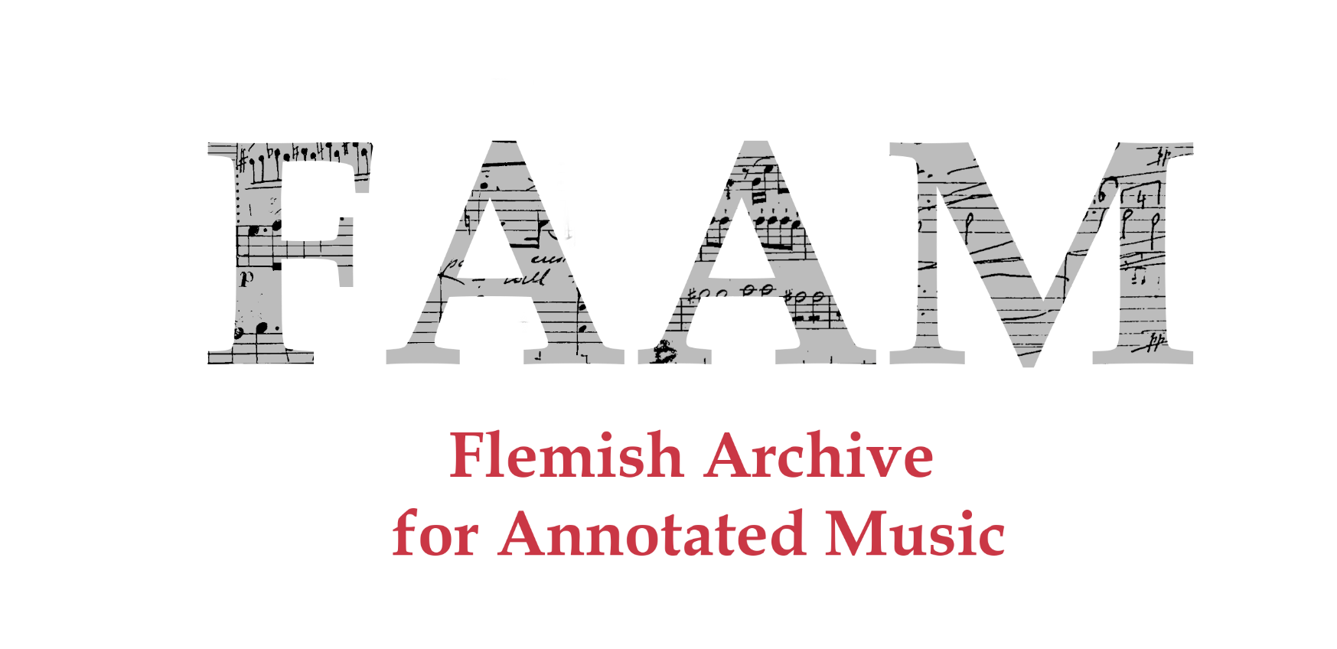


Nicholas Cornia, Hannah Aelvoet
Royal Conservatoire Antwerp, Labo XIX & XX
nicholas.cornia@ap.be, hannah.aelvoet@ap.be
José Oramas
University of Antwerp, imec-IDLab
jose.oramas@uantwerpen.be
Notes:
20/12 = 100 seconds

Slide 2
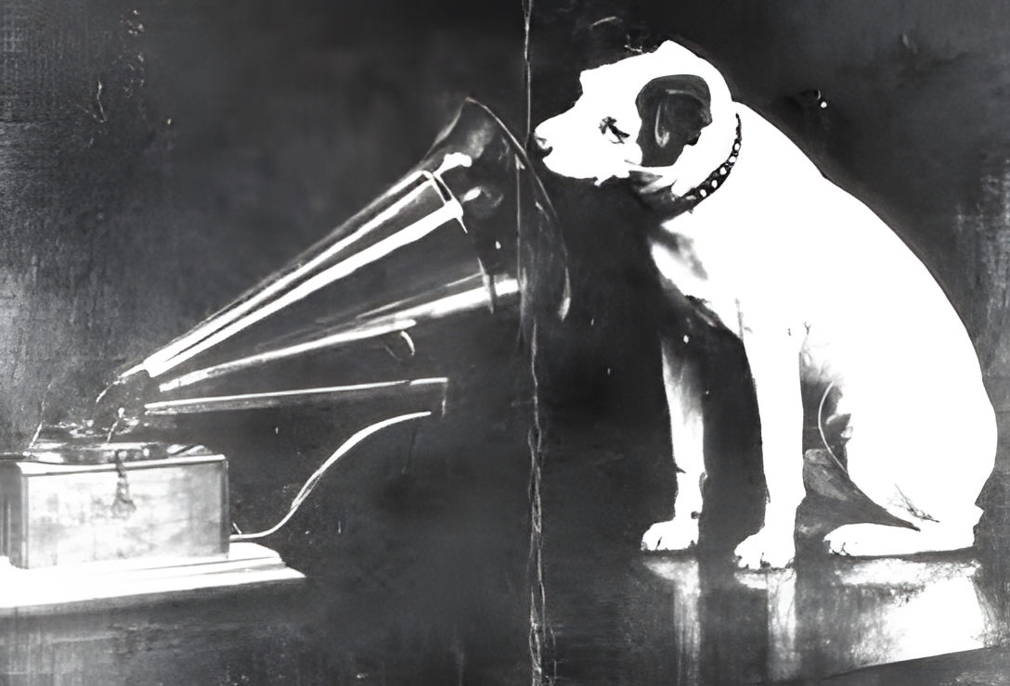
Mission
Recollecting the performance practice of pre-recording era musicians.
Retrieving the agency of the scribe and their interpretation of musical work.
Accessible opensource digital corpus for scholars and performers.
Notes:
Consider early recordings of Caruso, Debussy, Ragtime musicians…
Piano Rolls technology

Slide 3
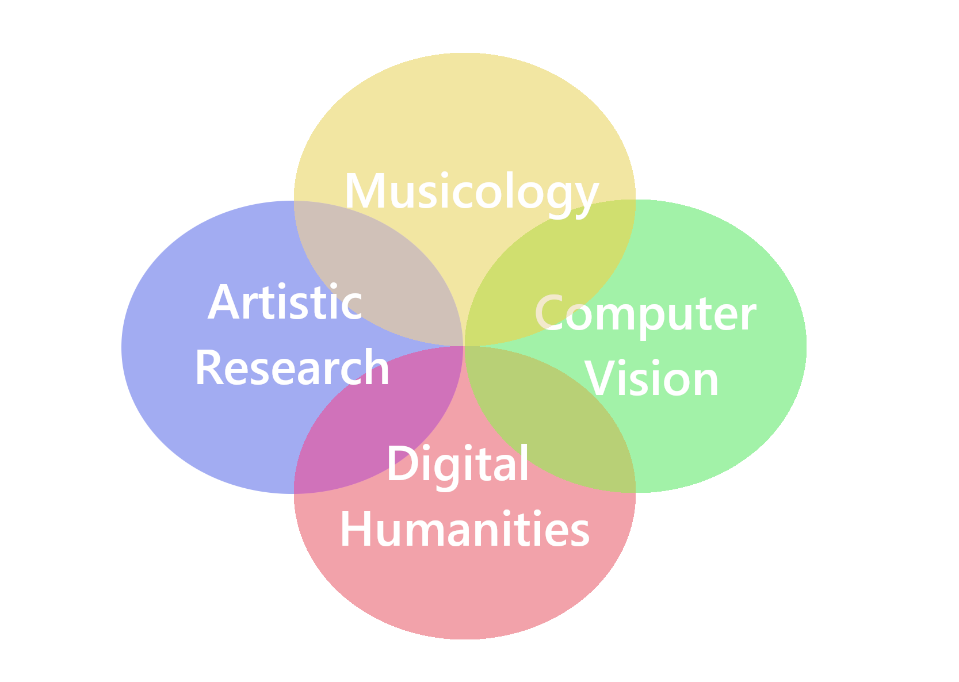
Multidisciplinarity
Computer Vision: creation of a dataset for the Optical Music Recognition and Information Retrieval research communities.
Digital Humanities: Provide a digital platform of handwritten annotated music for performers and researchers in the field of historical performance practice of the 19th and early 20th century within the FAIR and Linked Open Data principles.
Artistic Research: Scores annotated by musicians of the past provide a huge source for understanding the performance practice of the period.
Musicology: Analysis of annotation trends, reconstructing performances and authors’ styles.

Slide 4
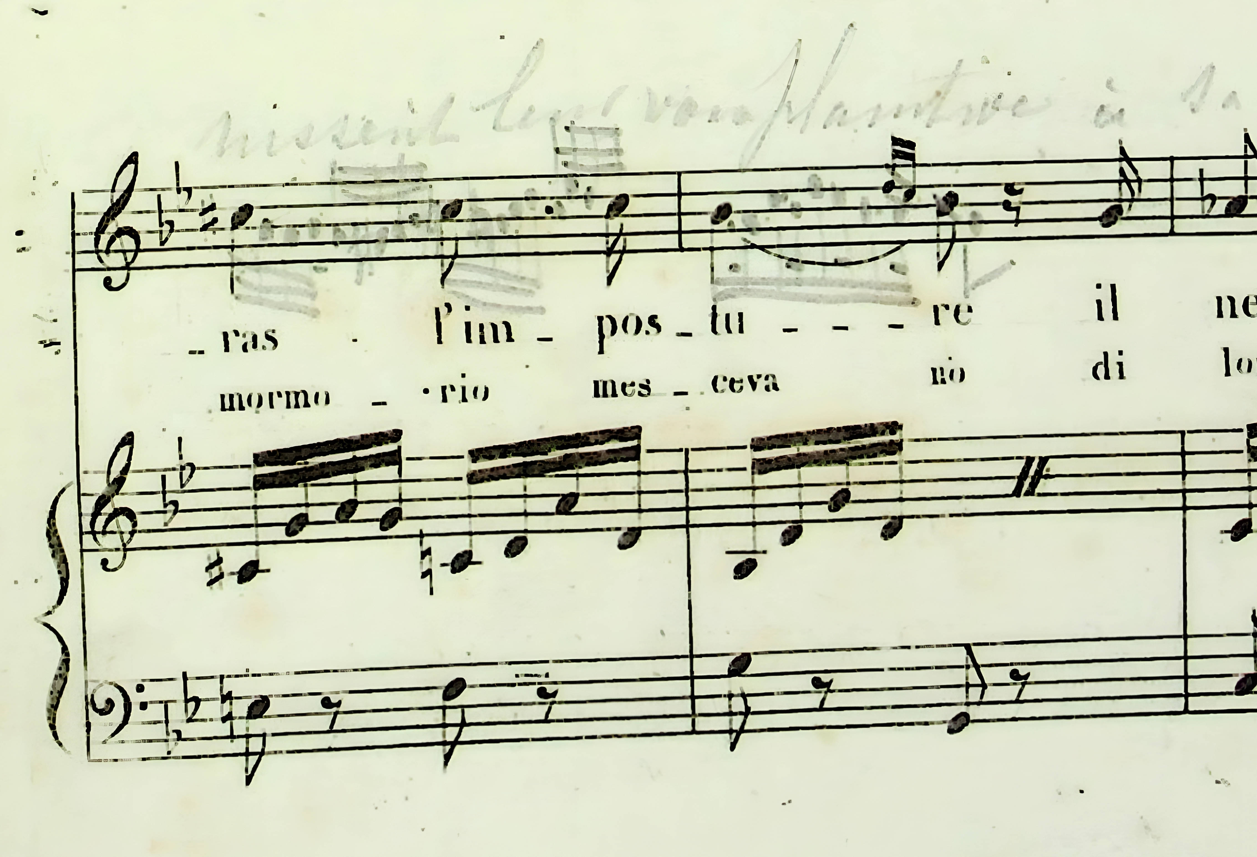
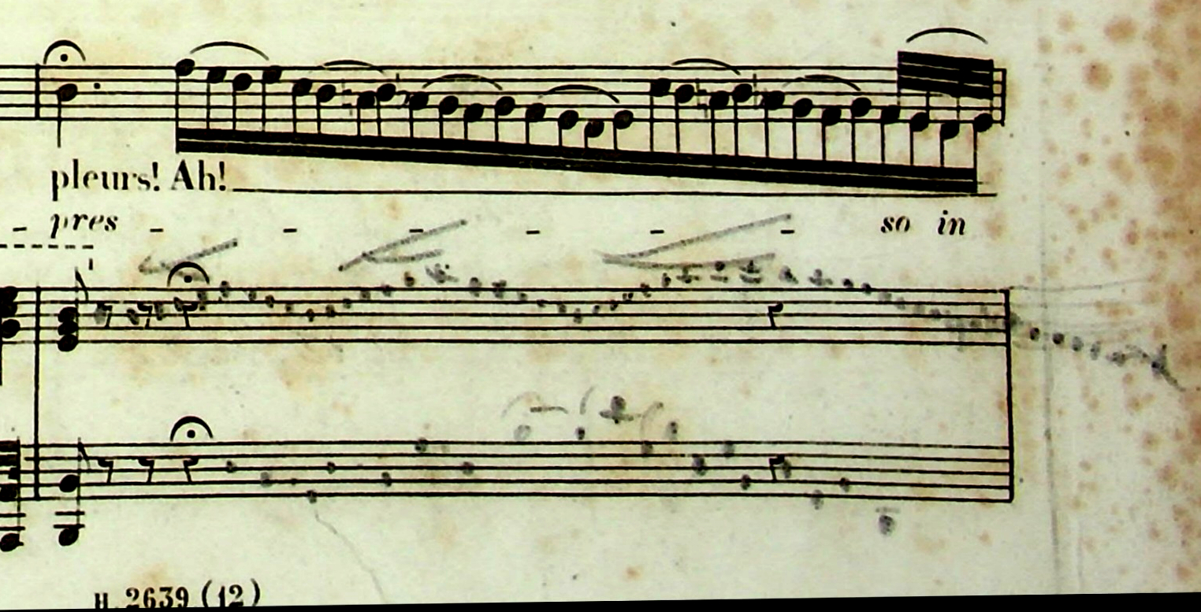
Degive Annotations
Valentine Degive-LeDelier (1846-1912) annotated songs collection
Notes:
Unbroken tradition of embellishments and cadenzas in Early Romantic repertoire
Unfortunately, other genres have lost this agency from the musicians…
Barbara Sciagura – cadenzas
(Simona Genga) https://www.youtube.com/watch?v=ARzr1rbGI8c (3 minutes)
Assisa ai piè – Embellishments and custom French lyrics
(Joyce di Donato) https://www.youtube.com/watch?v=7zk8W4OwjGk (5minutes)

Slide 5

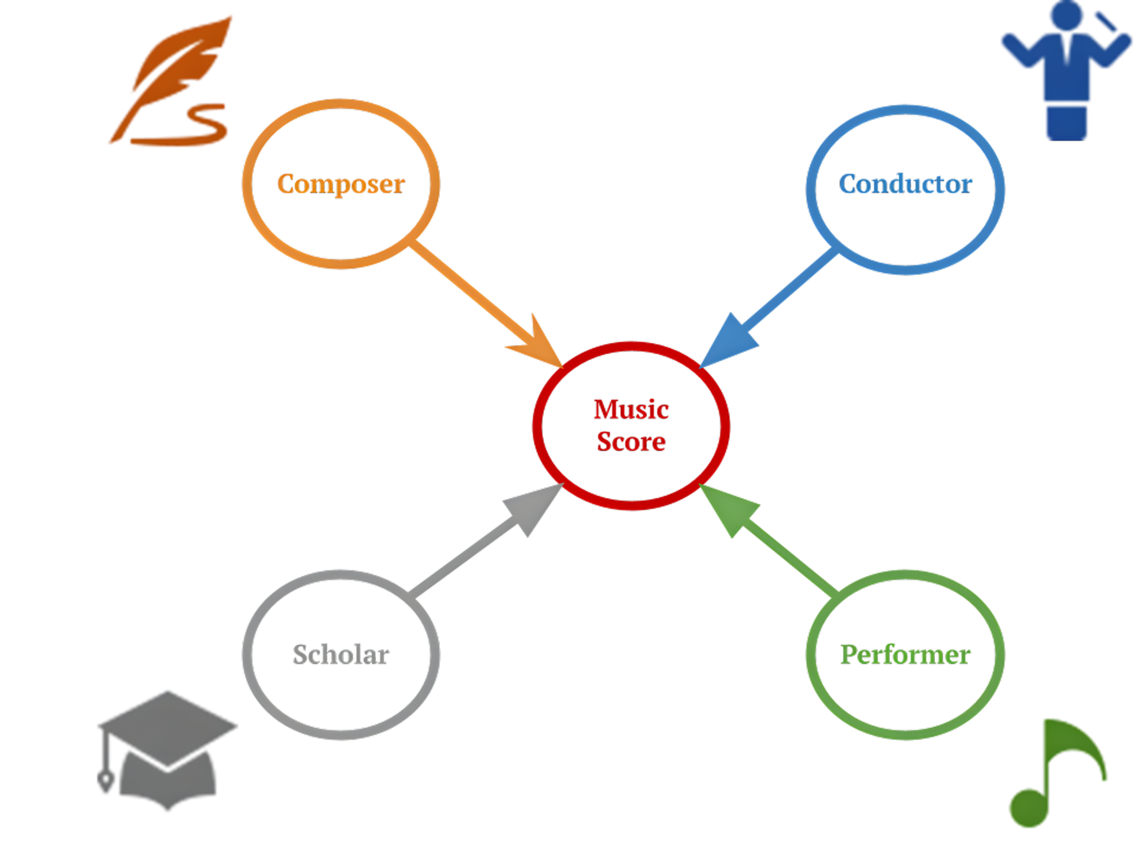



Annotators’ perspectives
Composer
Conductor
Performer
Scholar

Slide 6
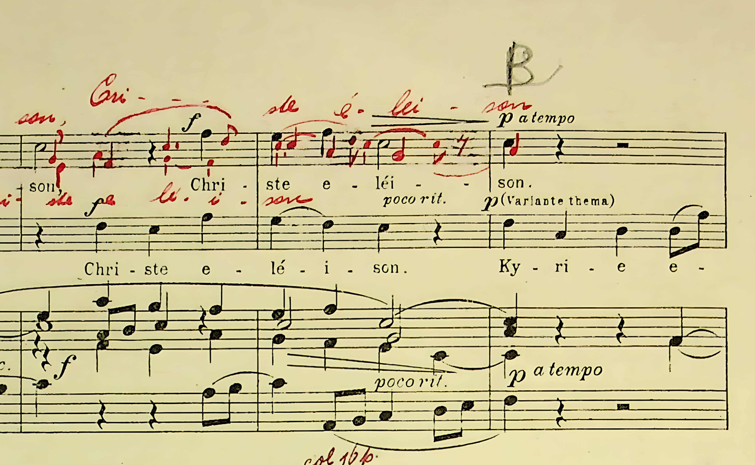
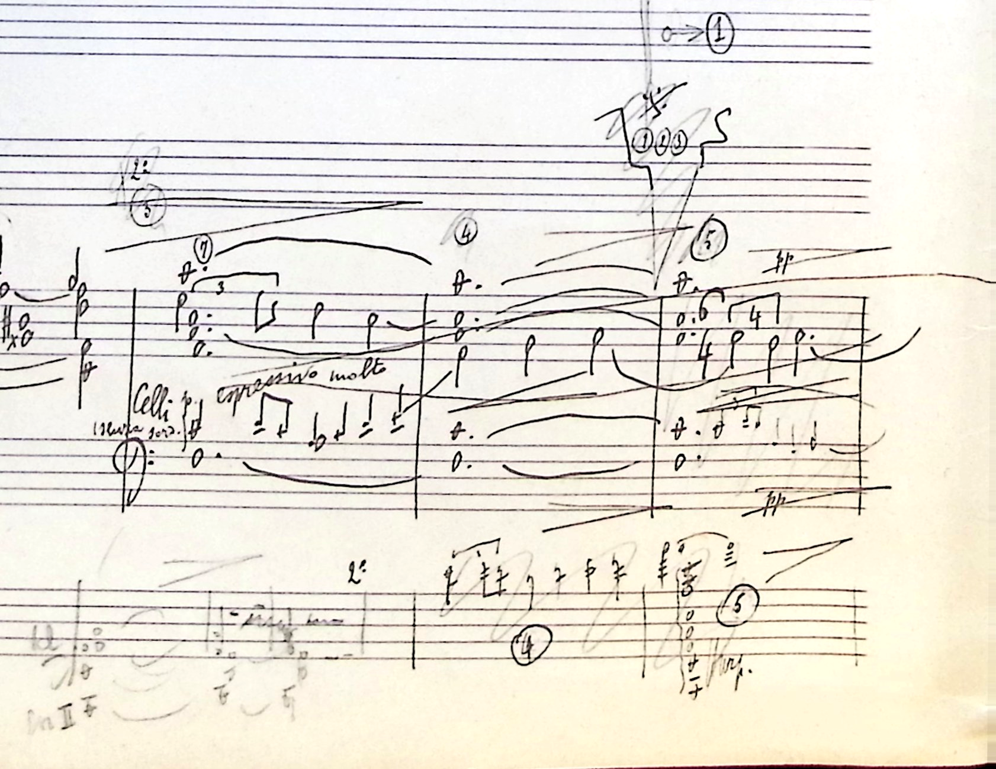
The Composer’s perspective
Recollecting the compositional process and changes made by composer with their own works.
Marinus De Jong (1891-1984) – Missa Ave Maria
Arthur Meulemans (1884-1966) – Beatrijs: Sinfonisch Poema
Notes:
Belgian pianist and composer of Dutch origin. After taking Belgian nationality he studied composition with Lodewijk Mortelmans and the piano with Emile Bosquet at the Antwerp Conservatory. He began his career as a piano virtuoso, touring Europe and the USA. Piano teacher at Antwerp Cons from 1931
The Dutch-born oboist and composer Frédéric Bonzon was the conductor of the band of the Chasseurs-Éclaireurs d’Anvers – Piece written for the 50th anniversary of the corp in 1910.
Arthur Meulemans Flemish composer and conductor, studies in Lemmensinstituut in Mechelen. Sketches with date of 1911.
Julianus Marie August De Boeck was a Flemish composer, organist and music pedagogue. He was the son of organist and director Florentinus (Flor) De Boeck (1826-1892). Studies at Brussels cons.
Reinaert de Vos (1909) Opera in 3 acts.

Slide 7

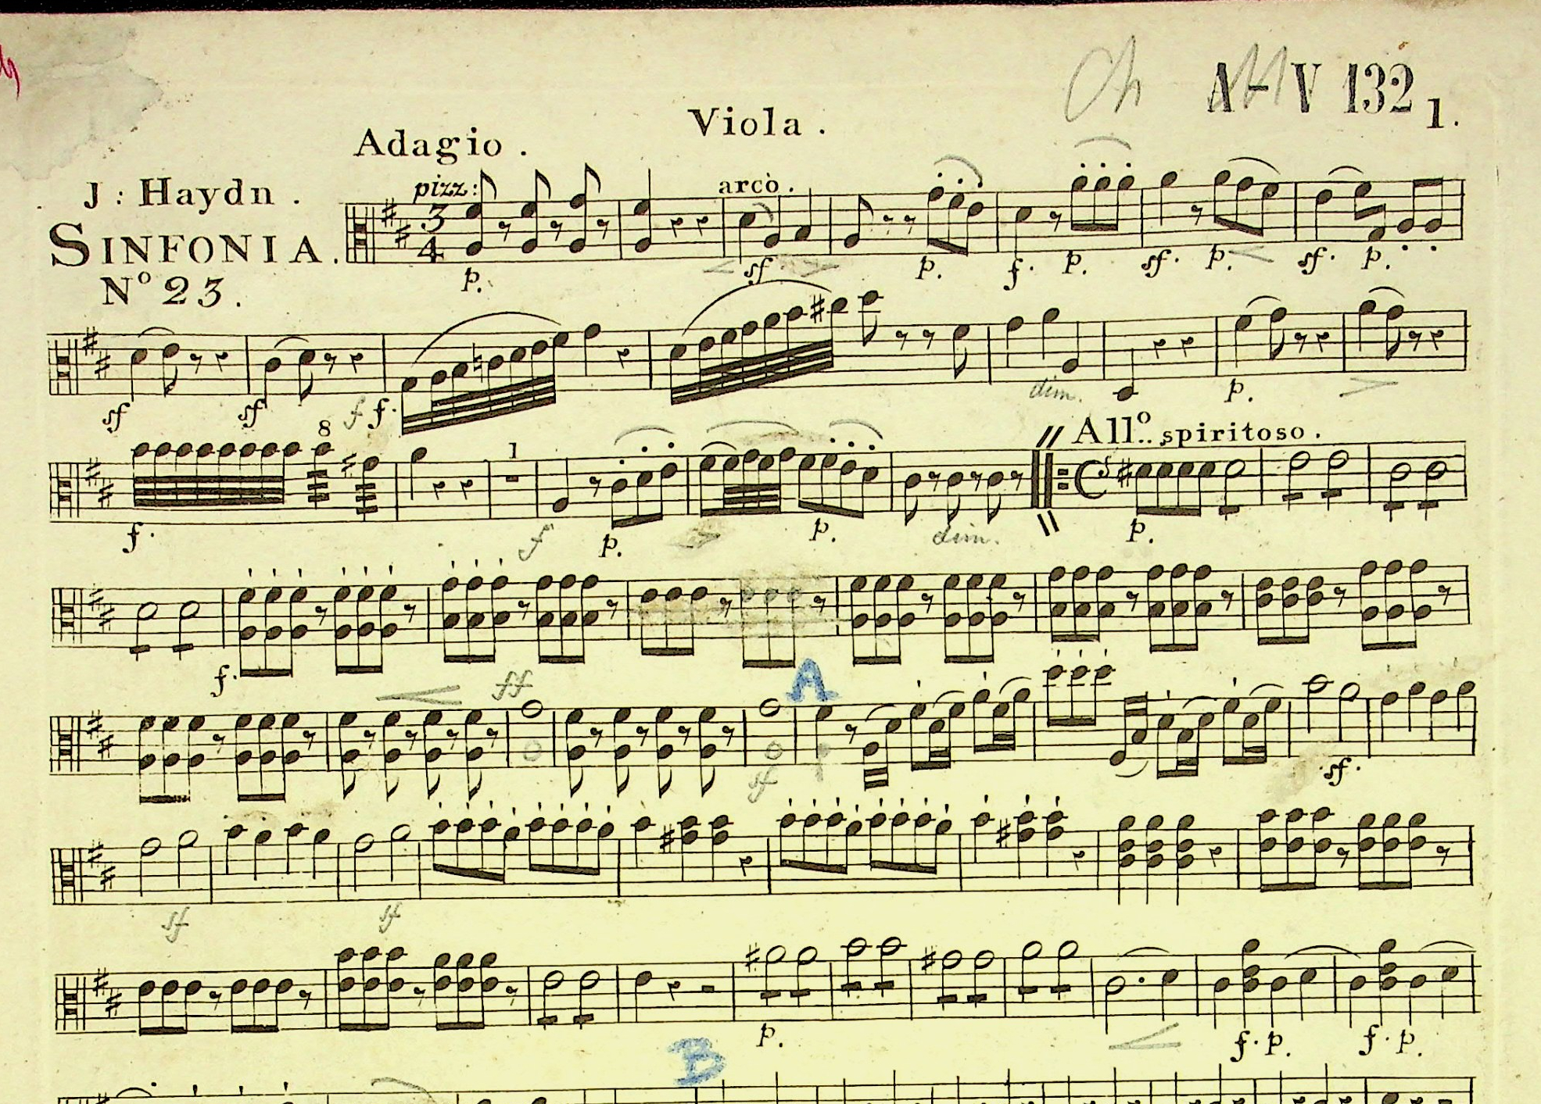
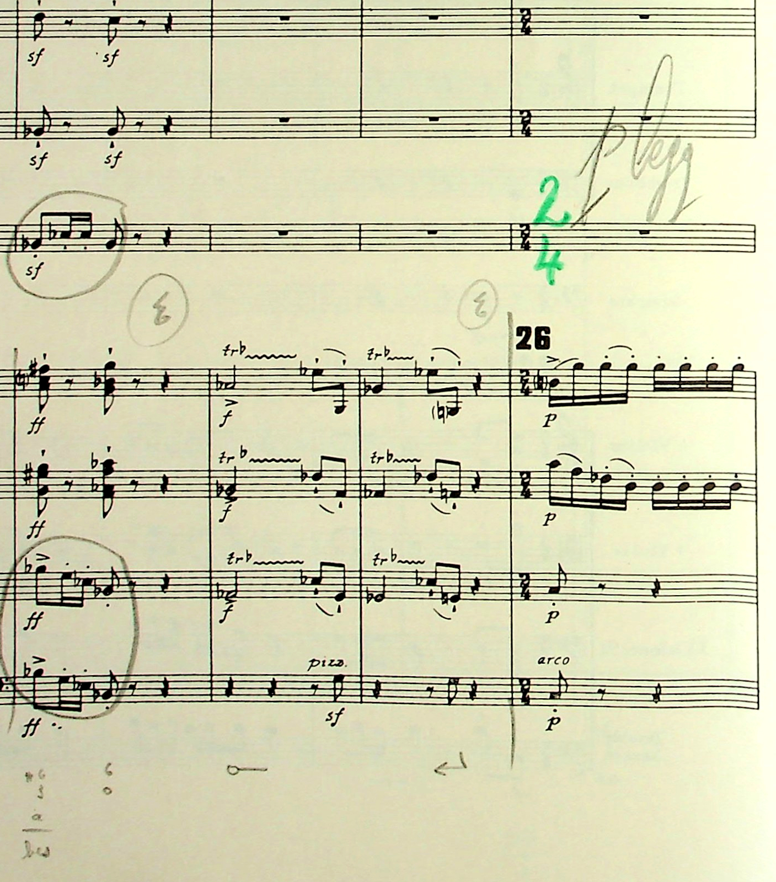
The Conductor’s perspective
Conductor’s choices and instructions. Styles of markings.
Karel Miry (1823-1889) Haydn’s Symphony N.23
Igor Stravinsky (1882-1971) Dances Concertantes
Notes:
Karel Miry, belgian composer who studies at the Ghent Conser with Joseph Mengal and in Brussels with Francois-Auguste Gevaert.
Teacher in Ghent from 1857
(12 August 1858, Ghent Conservatoire Orchestra)
Detailed marks and interpretation made on each part for the students.
Igor Stravinsky
(3 February 1942, Janssen Symphony Orchestra)
Composer performing and chaning his own work
Maurice Abravanel American conductor at Utah Symphony Orchestra from 1947, born in modern day Greece. He had to flee from Germany due to the Nazi persecution of Jewish people.
Collection of recordings and annotated conductor scores.

Slide 8
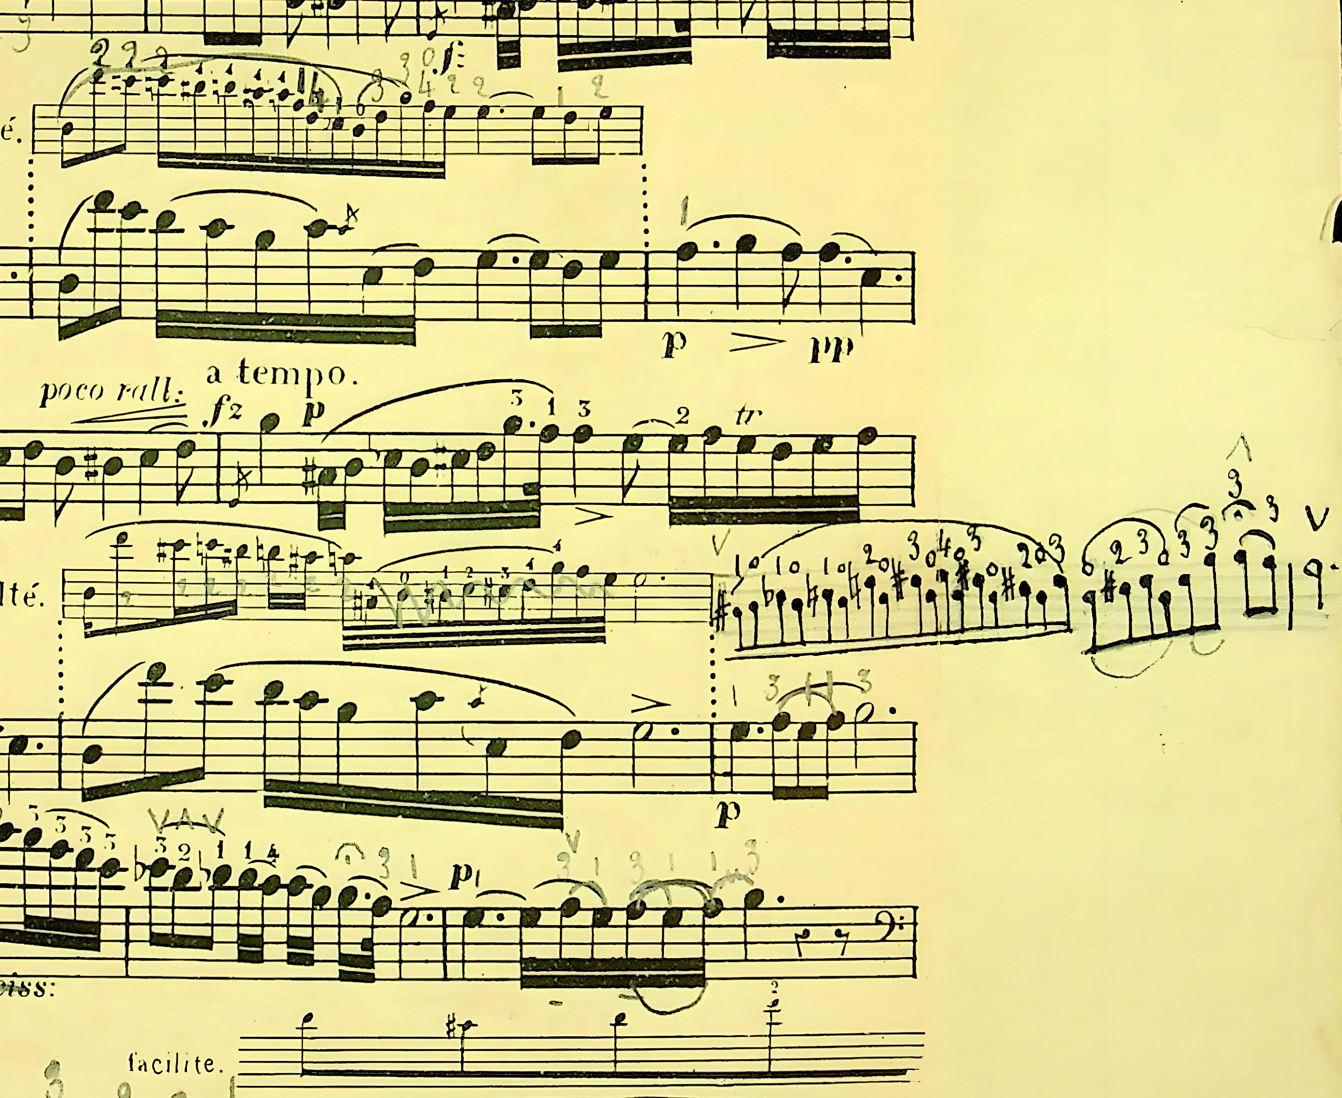
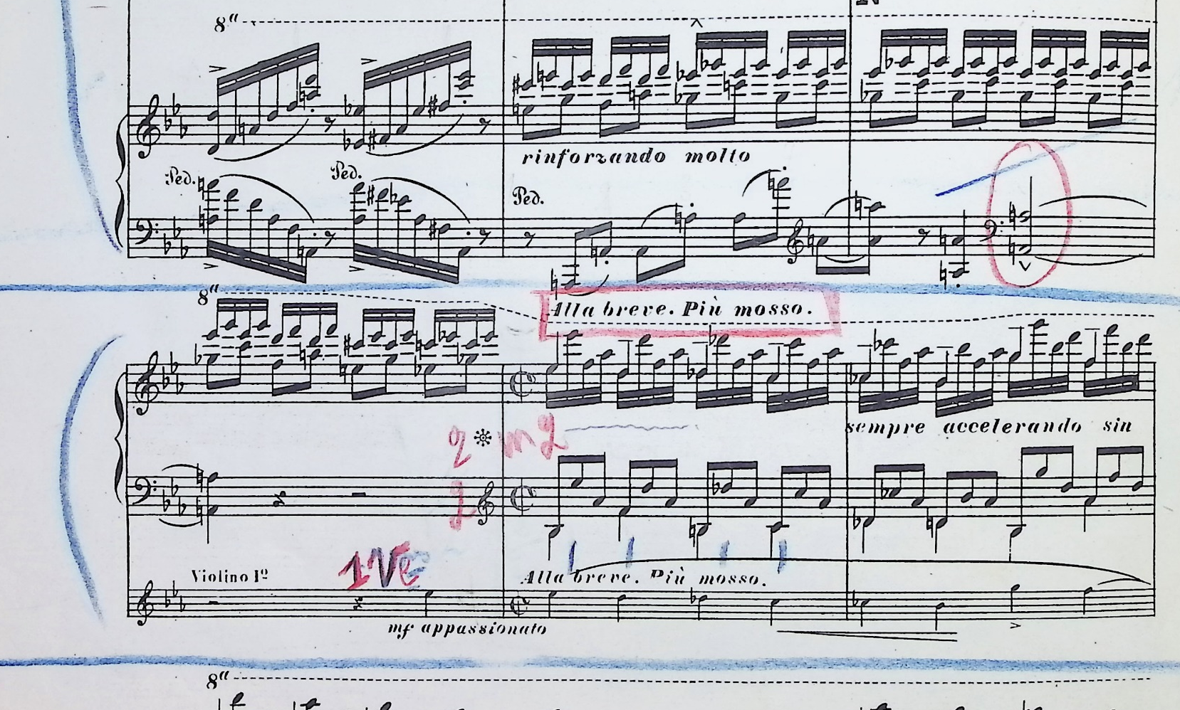
The Performer’s perspective
Retrieving the performance practice of pre-recording era musicians.
Léa Fauquel (?) – Servais’ arrangement of Chopin Nocturne Op. 9 N. 2
Hélène Dinsart (188é-1968) Liszt’s Piano Concerto N. 1
Notes:
Léa Fauquel – Adrien-Francois Servais (1807-1866) arrangement of Frederic Chopin Nocturne Op. 9 n. 2
Brussels pianist and teacher Hélène Dinsart (1882-1968)
Lode Backx studies piano at the Antwerp Conservatoire, with Marinus De Jong as teacher. Degree in 1942.

Slide 9
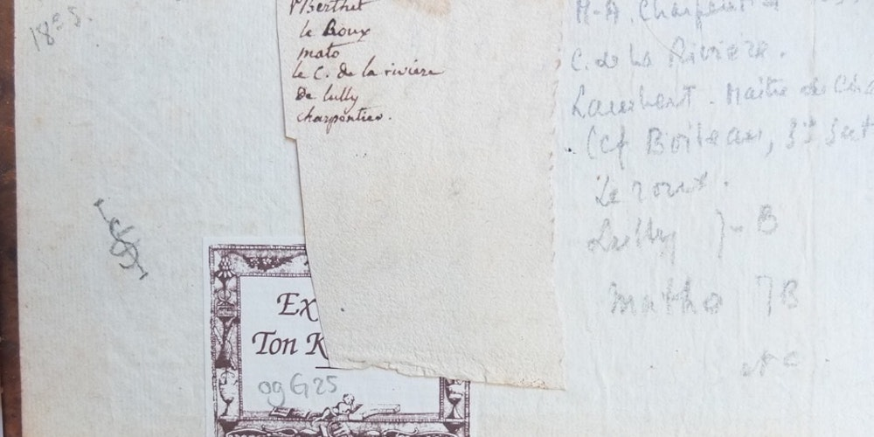
The Scholar
Scholars, like musicologists, historians, libriarians, pedagogues and music collectors intensively annotate music scores for various purposes, such as cataloguing.
Ton Koopman – Orpheus Insitute Resounding Libraries project

Slide 10
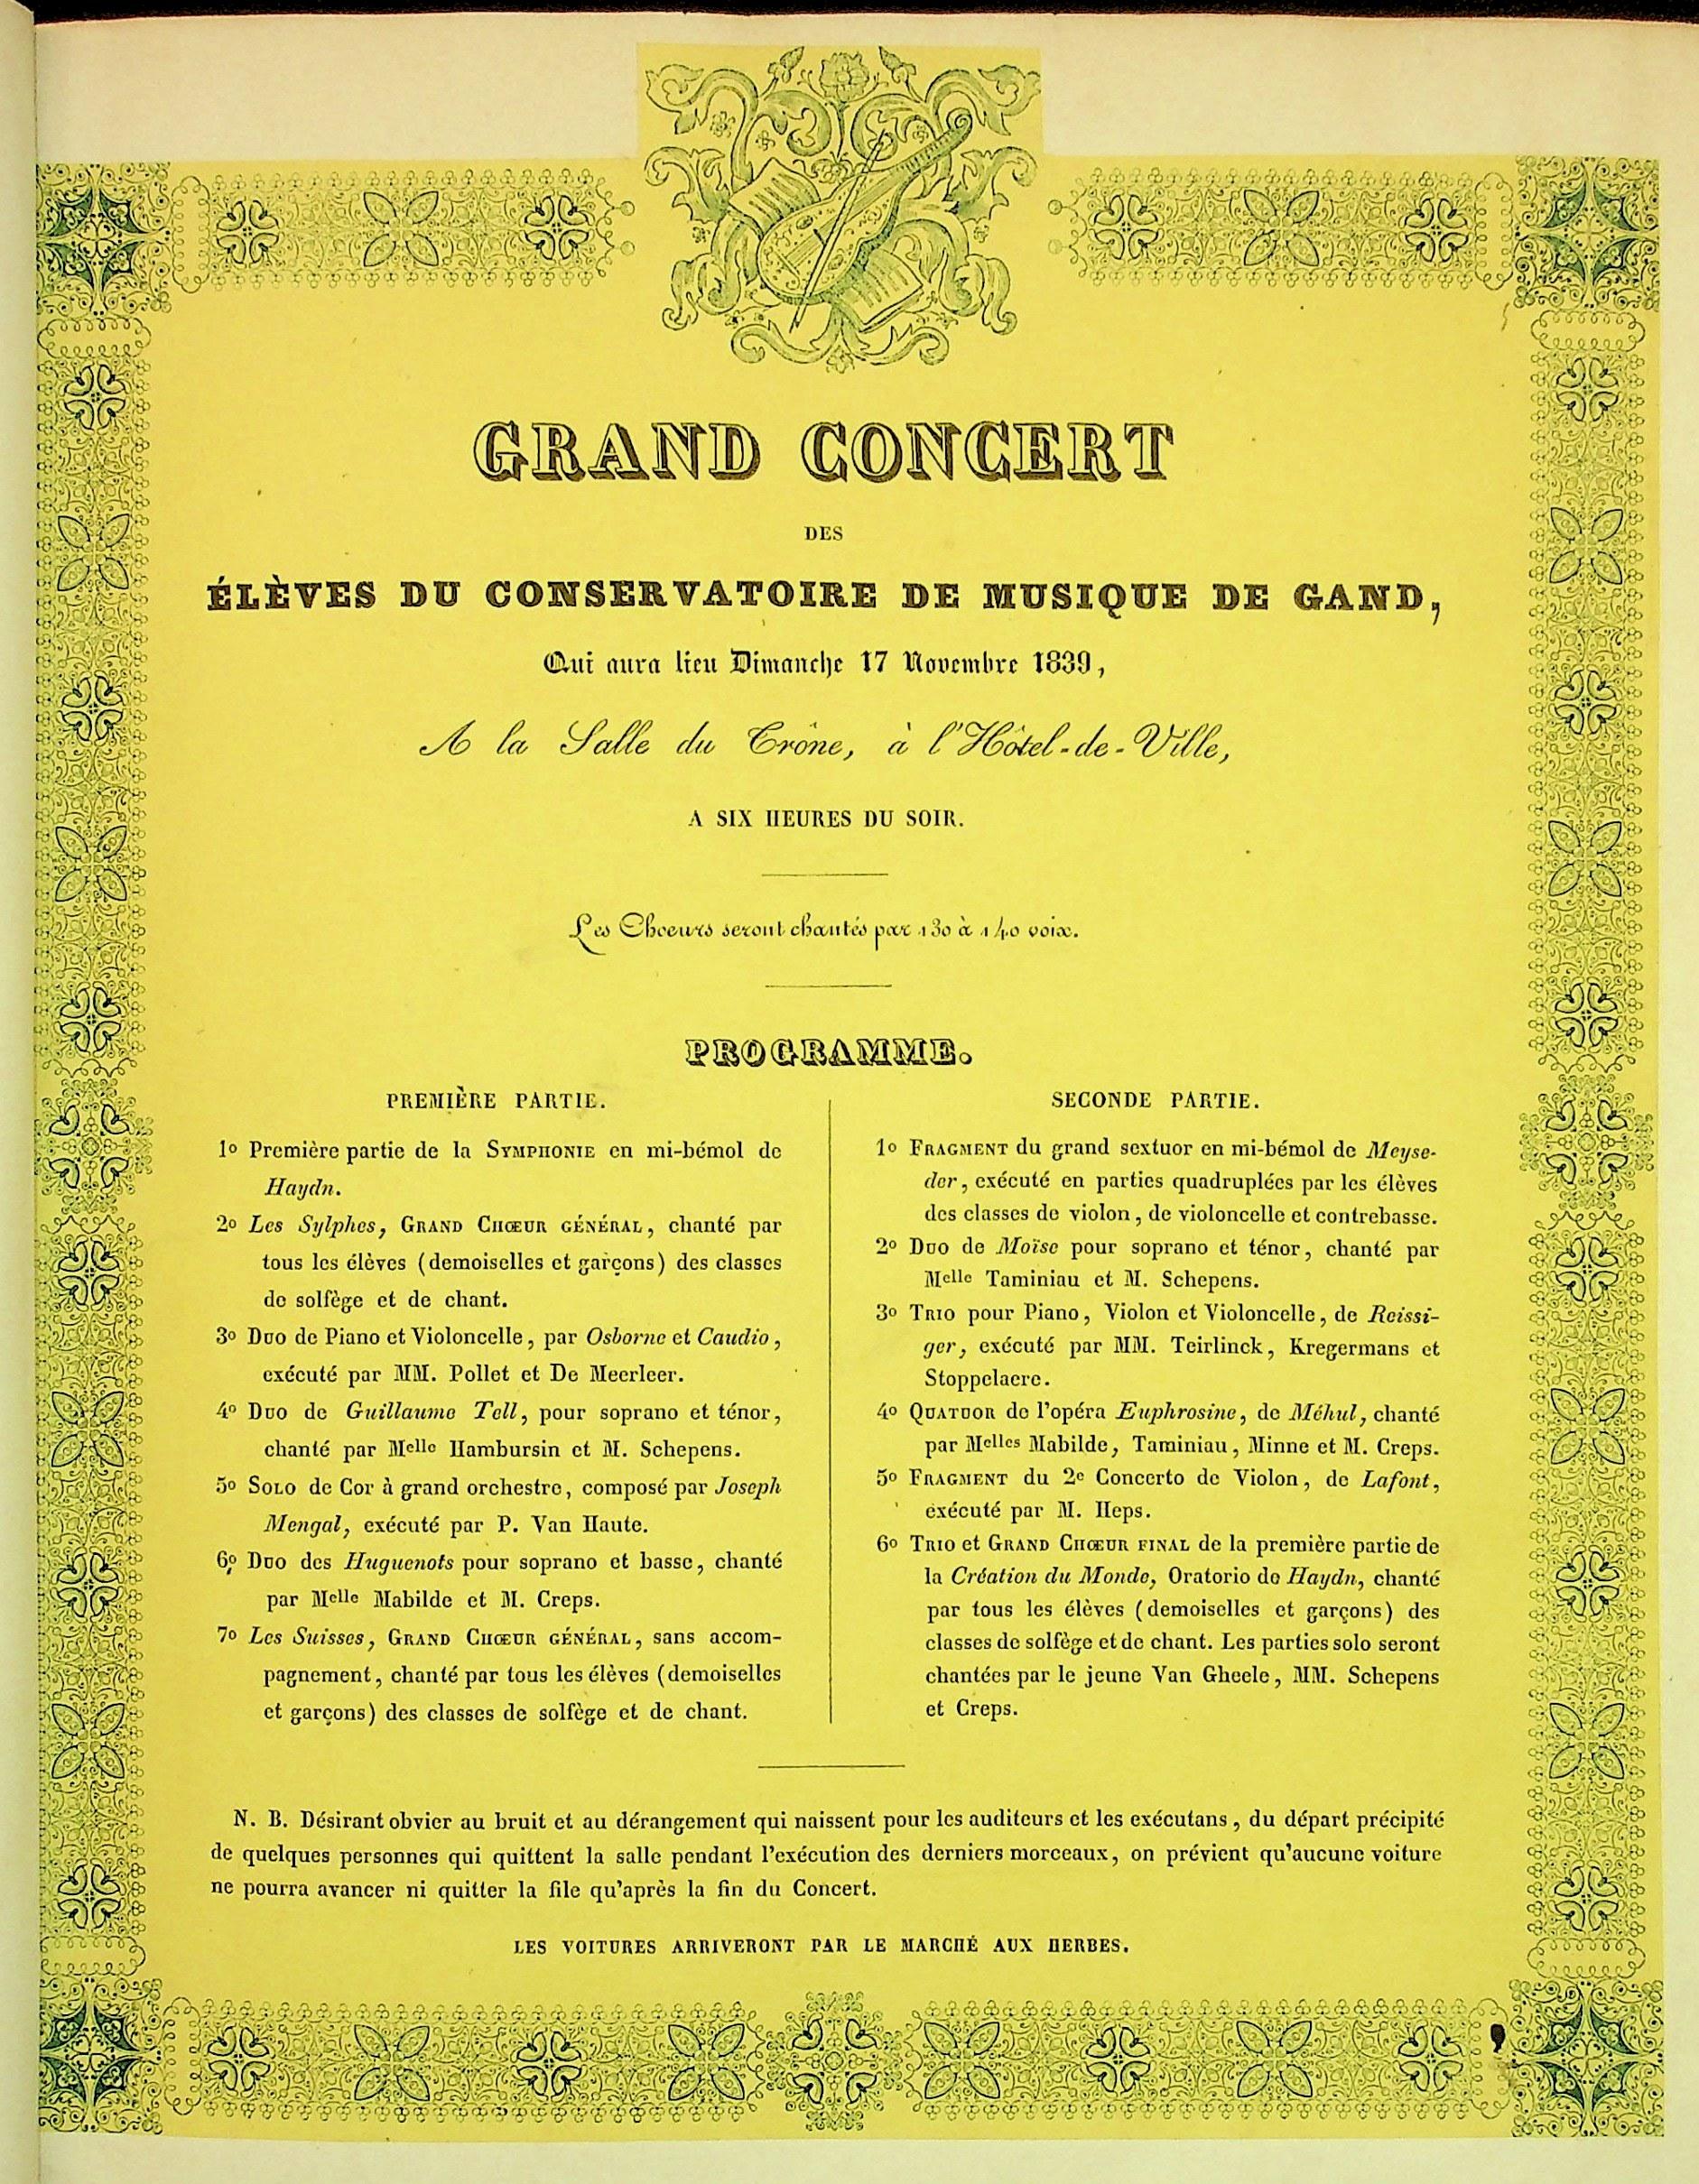
Recollecting conservatoire’s legacies
Reconstructing performance practice and pedagogical trends through annotated scores from Flemish conservatoires’ exam concert programmes.
Royal Conservatoire Ghent (1836-1972)
Royal Conservatoire Antwerp (1899-1912)

Slide 11
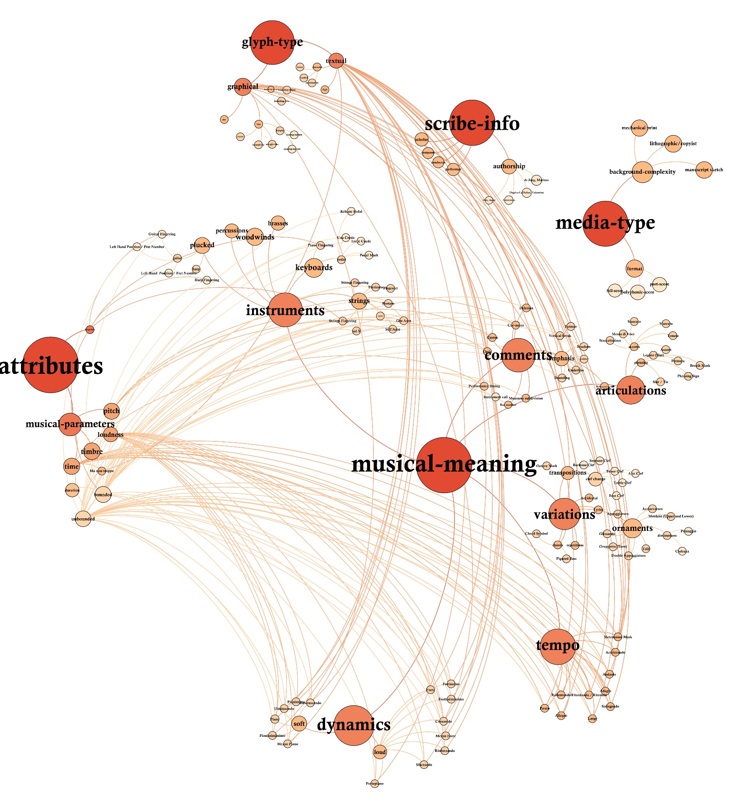
Music Ontology
Analysis of musicians’ annotations: Winget (2006-08), de Magalhaes Ganizeo (2019), Morabito (2020-21) and Staruch-Smolec (2021-22).
Ontology for music objects: Giullote-Nothmann, Poltronieri, de Berardinis et al. (2021)
Notes:
Definitions of Ontology
A **conceptualization** is an abstract, simplified view of the world that we wish to represent for some purpose.
An **ontology** is an explicit specification of a conceptualization. The term is borrowed from philosophy, where an Ontology is a systematic account of Existence.
The knowledge graph is based on vertices (set of objects) and edges (their relationships).
Pragmatically, a common ontology defines the vocabulary with which queries and assertions are exchanged among agents.

Slide 12
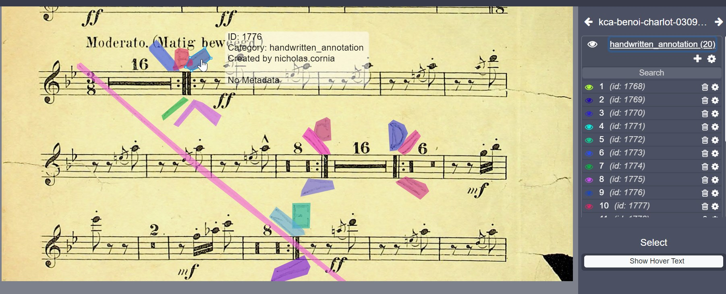
FAAM dataset
Training dataset development
COCO-json format
Pixel region of handwritten annotation
Metadata enrichment
Notes:
Training set: 4226 images , 317 annotated -> handwritten annotation label
4342 polygonal bounding-boxes objects

Slide 13








Partners
Notes:
CHASE project and other research based on annotation spotting. Synchronizing existing datasets with images.
Jan Aelterman and José Oramas. Wim Casteels

Slide 14
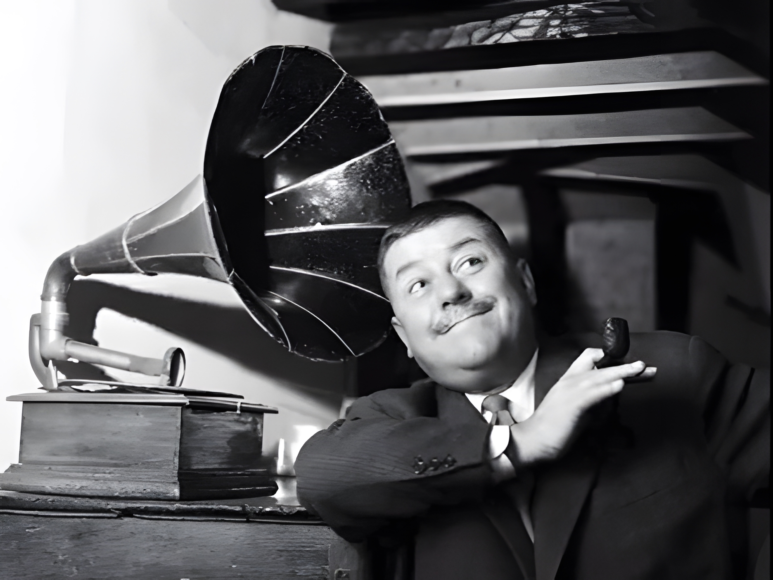
Conclusion
nicholas.cornia@ap.be
Notes:
Dankwoord – Lamyk, Sally, all the networking and colleagues
Vragen
Mogelijkheden voor samenwerking – CLARIAH, other libraries

